Slide 1
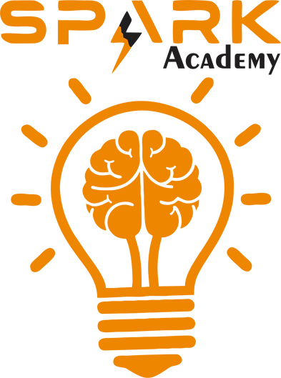
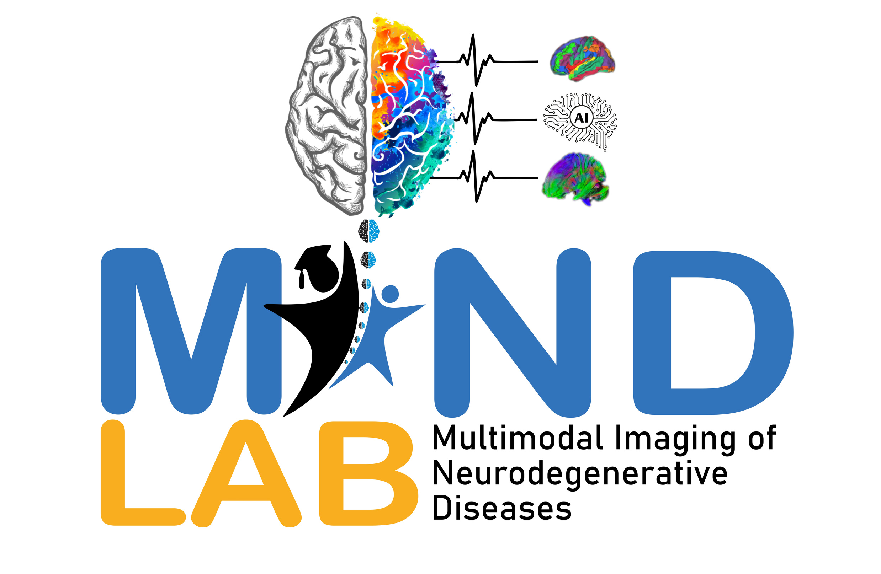


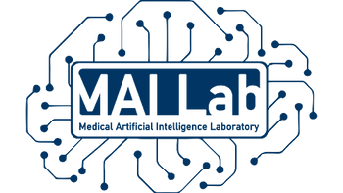
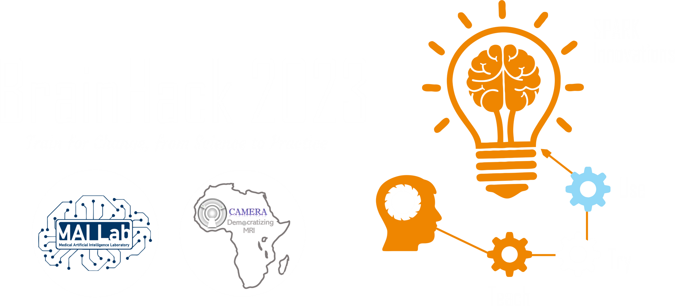
2025 SPARK ACADEMY
TRAIN FOR CHANGE, FROM SCIENCE TO PRACTICE
THE SPRINT AI TRAINING FOR AFRICAN MEDICAL
Imaging Knowledge Translation (SPARK)
Academy
IN DEEP LEARNING & MEDICAL IMAGING
Virtual Foundational Course Tutorial
Advanced Deep Learning Techniques II
Diffusion Models: Denoising Diffusion Probabilistic Models
April 26th, 2025

Slide 2
Outline
Introduction
Theoretical Framework
Implementation Methodology
https://event.fourwaves.com/spark

Slide 3

Introduction
Published: Feb 2021
https://arxiv.org/abs/2102.09672
Published: Jun 2020
https://arxiv.org/abs/2006.11239
https://event.fourwaves.com/spark

Slide 4
Introduction
Published: Jun 2020
Published: May 2021
https://arxiv.org/abs/2105.05233
https://arxiv.org/abs/2207.12598
https://event.fourwaves.com/spark

Slide 5
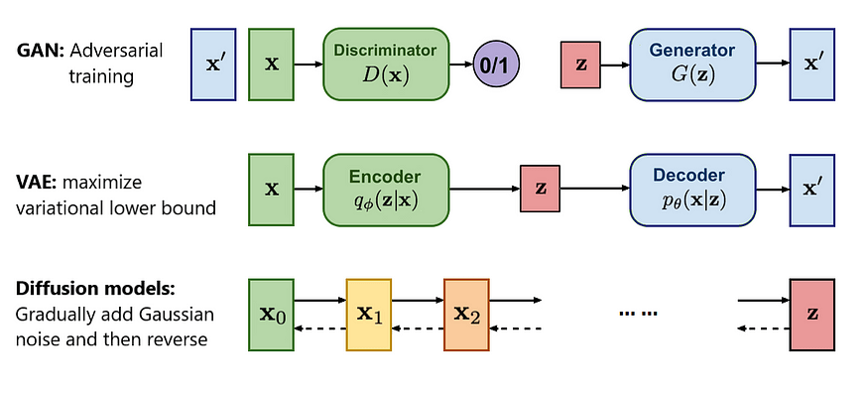
Generative Models
https://event.fourwaves.com/spark

Slide 6
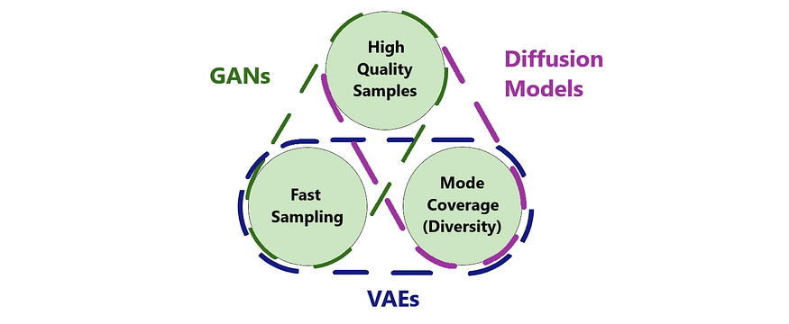
Strengths and weaknesses of models
https://event.fourwaves.com/spark

Slide 7
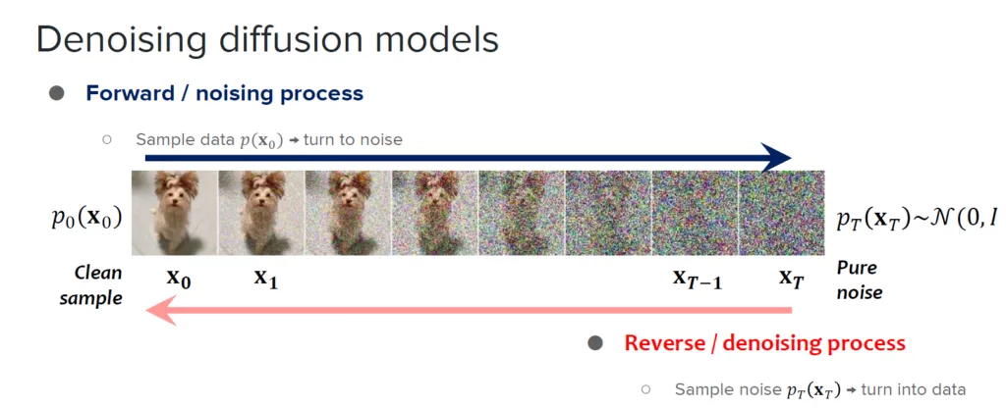
Introduction to Diffusion Model
Diffusion Process
Forward Process (q)
Creating noisy images
Based on Markov chain
Reverse Process (p)
Denoising the noisy images
https://medium.com/@saptarshimt/sr3-super-resolution-diffusion-via-iterative-refinement-a-simple-tensorflow-implementation-from-18708a64f280
https://event.fourwaves.com/spark

Slide 8
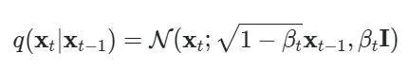
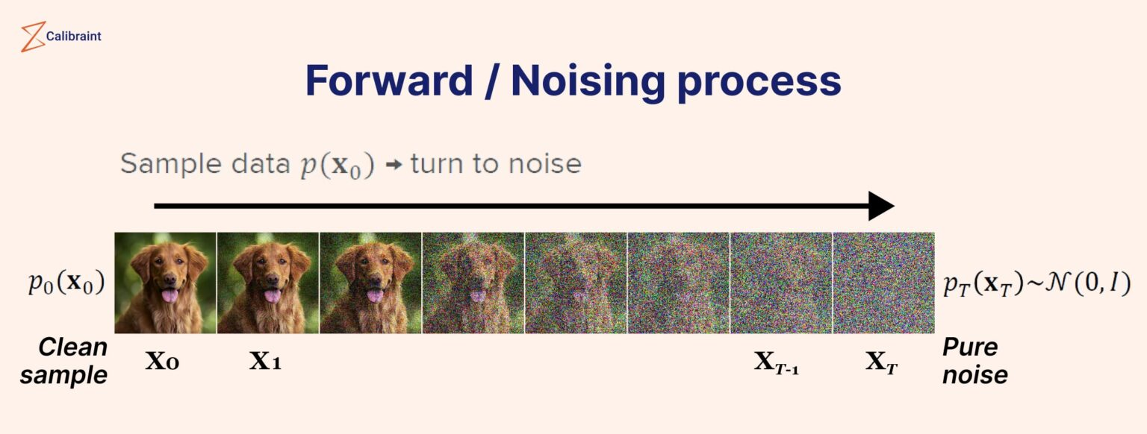

Forward Process
Forward Process
Work by successive addition of Gaussian noise through various time steps typically 1000
The noise will be added gradually during many (T) small steps
T = 1000
The model’s objective is to learn a function that, at each step t, predicts both the mean and variance needed to invert this process and recover $x_{t−1}$ from $x_{t}$
https://event.fourwaves.com/spark
https://www.calibraint.com/blog/beginners-guide-to-diffusion-models

Slide 9
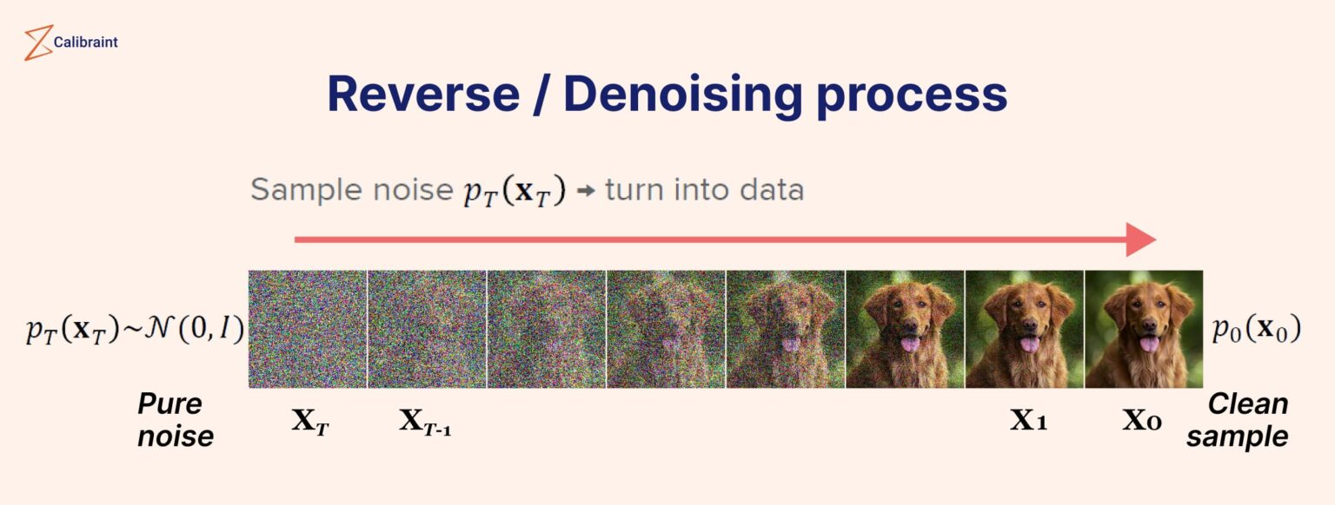
Reverse Process
Reverse Process
It starts from a noise sample ε and ends at a data sample x. At each step t, the noise is reduced by subtracting Gaussian noise from it. The noise level decreases as t decreases until it reaches 0 at the initial step 0
The goal of a diffusion model is to learn the reverse denoising process, iteratively undoing the forward diffusion.
After the forward diffusion is complete, the model trains a function that predicts the mean and variance at each reverse timestep.
By applying this learned reverse process to random noise, the model effectively generates new data samples.
https://event.fourwaves.com/spark
https://www.calibraint.com/blog/beginners-guide-to-diffusion-models

Slide 10
Denoising Diffusion Probabilistic Model
DPMs rely on mathematical formulations to reverse the diffusion process, whereas DDPMs use UNet architecture and self‑attention to model that reversal
Both approaches predict noise levels at each diffusion step to reconstruct the original data
The primary objective is to generate high‑quality samples
DDPMs introduce a more advanced training approach by leveraging denoising score matching (DSM) to quantify the model’s ability to remove noise
Applying DSM at every step allows DDPMs to enhance denoising beyond the basic reversal focus of standard DPMs
https://event.fourwaves.com/spark

Slide 11
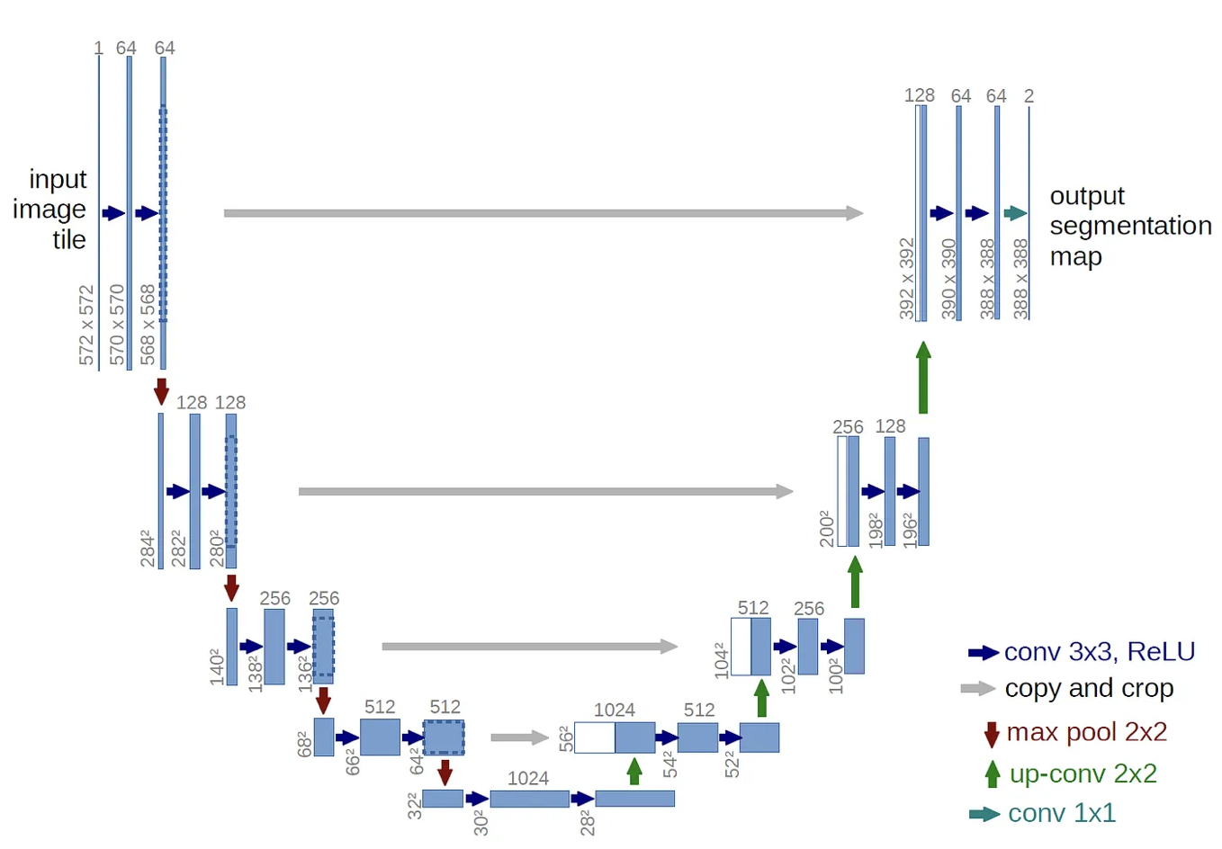

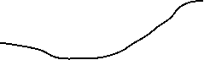
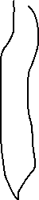

Model Architecture
Add residual blocks
Incorporate QKV self‑attention
Embed timestep information into each layer
Integrate ConvNeXT blocks
Adding residual blocks with self attention
T
T
T
T
T
T
T
https://event.fourwaves.com/spark

Slide 12
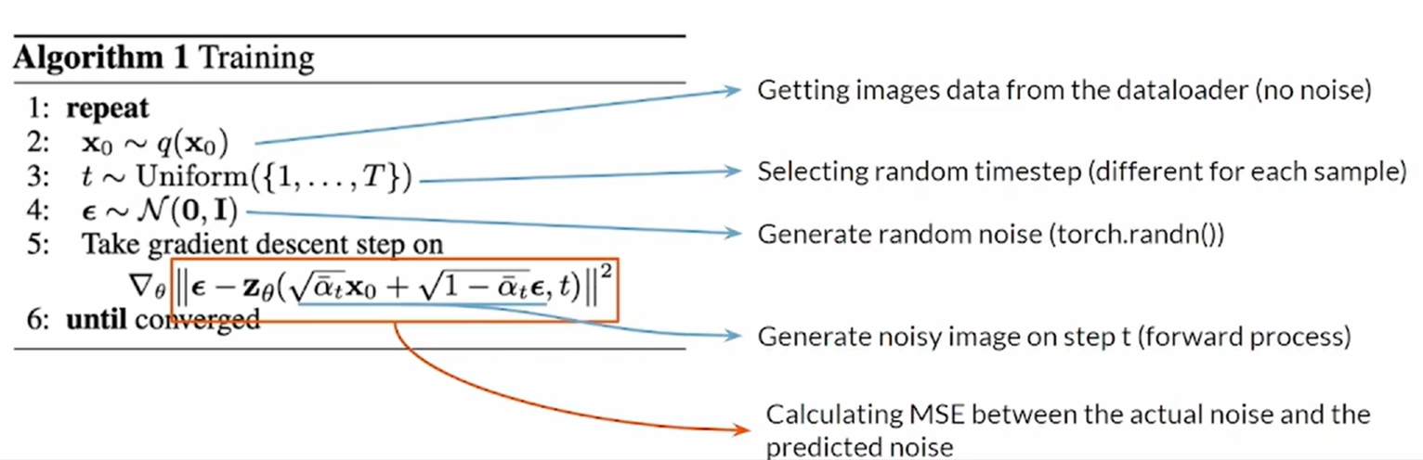
During Training Process
https://event.fourwaves.com/spark

Slide 13
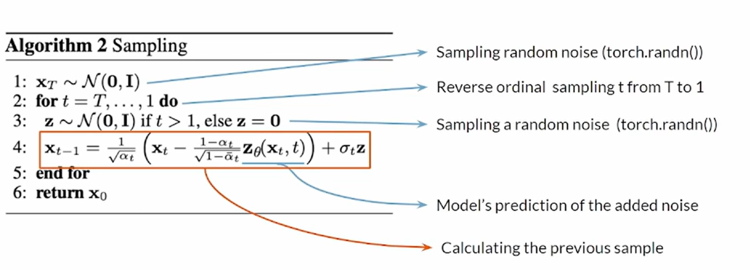
During Inference Process
https://event.fourwaves.com/spark

Slide 14
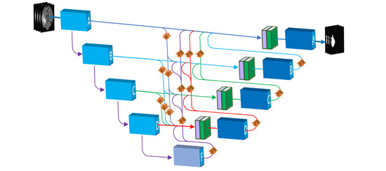
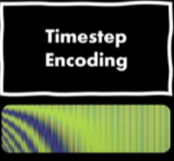
How to Implement (3 Main Steps)
Noise Scheduler
Neural Network
https://event.fourwaves.com/spark

Slide 15
Code Demo
Code Implementation
Noise Scheduler
Neural Network (Unet) with Timesteps
Time Encoding
https://event.fourwaves.com/spark

Slide 16
Resources
Comparison: https://towardsai.net/p/generative-ai/diffusion-models-vs-gans-vs-vaes-comparison-of-deep-generative-models
Flow Models: https://lilianweng.github.io/posts/2018-10-13-flow-models/
Positional Encoding: https://www.analyticsvidhya.com/blog/2024/07/positional-encoding-stable-diffusion/
Stable Diffusion: https://www.linkedin.com/pulse/how-does-stable-diffusion-work-rizwan-ud-din-phvlf/
Mastery: https://machinelearningmastery.com/a-gentle-introduction-to-positional-encoding-in-transformer-models-part-1/
https://event.fourwaves.com/spark

